Slide 1

FoodCorp Regional Performance Analysis for Marketing Investment
Submitted by
Tamasree Chakraborty
Student ID - 20644459

Slide 2
Executive Summary : This report presents a detailed analysis of FoodCorp's regional store performance to support the management in identifying the most promising store for increased marketing investment. FoodCorp, a growing company with four stores across London, Birmingham, and Nottingham, seeks to determine which store offers the best growth opportunities for increased marketing investment. This analysis evaluates sales performance, customer behavior, product trends, store performance. Visualizing and analyzing different metrics will help us to make a business decision. Using these insights, the report identifies growth opportunities and provides actionable recommendations to optimize marketing and distribution strategies based on key performance indicators (KPIs).
Data Cleaning & Preparation Steps: Firstly, The data was cleaned and pre-processed to ensure accuracy and consistency for analysis. When analyzing data for a business like FoodCorp, it is needed to organize the data in a way that facilitates efficient querying, insightful analysis, and intuitive reporting. This is achieved by designing a data warehouse schema using fact and dimension tables. Note: In the ‘stores_dim’ created as dimension table, A new column called ‘Store Location’ was added to uniquely identify store names. It will replace the store codes with combination of city and first-part of postal code like ‘London EC3V’ to easily identify and analyze the dataset for each stores / region .
The KPIs : To effectively compare the three regions (London, Birmingham, and Nottingham), we will define Key Performance Indicators (KPIs) that capture both point-in-time performance and trends over time. These KPIs are divided into store performance, customer behavior, and trends. The charts for each KPIs are discussed in next slides.

Slide 3
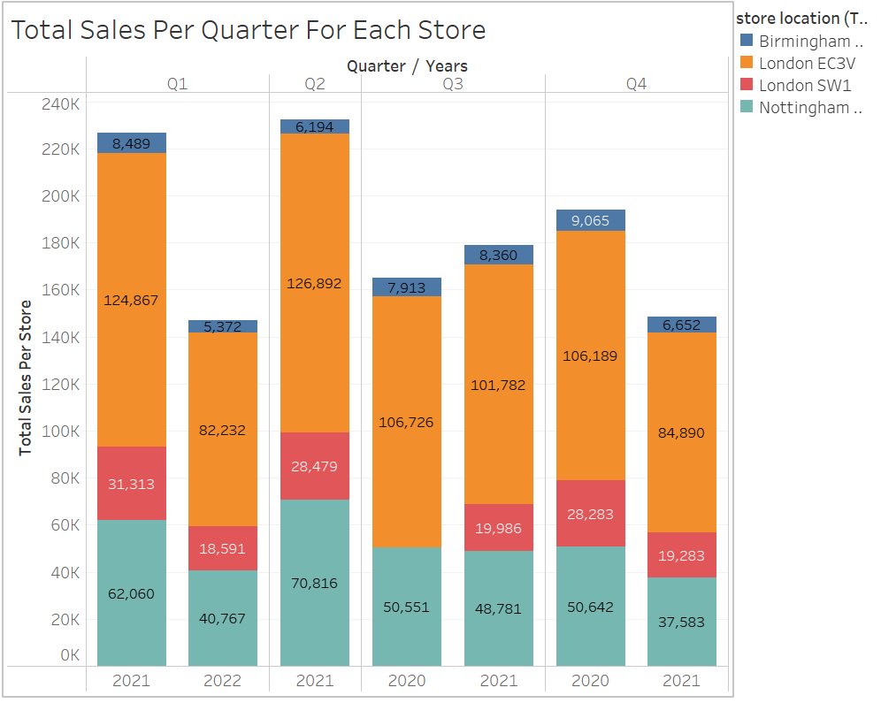
A. Sales Performance Metrics – KPI 1: Total Sales for Each Stores Per Quarter a) Purpose :Total Sales made by Customers in each store for a given period. b) Formula: Sum of Value , Group By & Order By -store location, year & Quarter c) Insights: London EC3V Dominates: London EC3V consistently outperforms other locations in total quarterly sales across all years. Particularly strong in Q1 and Q2 of 2021 and 2022, indicating a stable customer base and strong demand.
London SW1's Moderate Performance: London SW1 shows a steady contribution but lags behind London EC3V. Nottingham NG1: Nottingham NG1 has a fluctuating performance, with a significant sales drop in 2021 compared to 2020.The recovery in 2022 indicates potential for growth with the right strategies. Birmingham B1's Underperformance: Birmingham B1 records the lowest sales across all quarters and years. Consistently lower than other stores, indicating challenges in market penetration or customer retention.
Figure 1 :Total Sales Per Quarter for Each Store

Slide 4
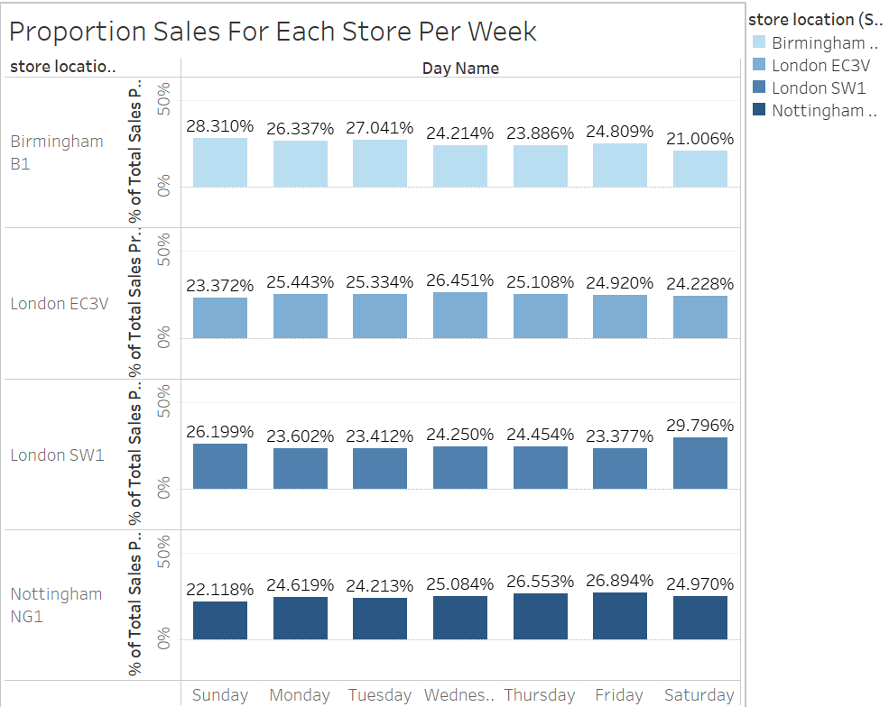
A. Sales Performance Metrics – KPI 2: Sales Rate Per Day of Week
a) Purpose: Proportion of sales acquired by each store location in a weekday.
b) Formula: Sum of Value (Total Daily Sales)/ sum of Total sales across the store. c) Insight :
Birmingham B1:Sunday has the highest proportion of sales (28.31%), followed by Tuesday (27.04%).Saturday shows the lowest sales proportion (21.01%), indicating reduced customer activity on weekends compared to weekdays.
London EC3V: Sales are more evenly distributed across the week, with a slight peak on Thursday (26.45%). Sunday (23.37%) has the lowest sales proportion, suggesting reduced activity.
London SW1: Saturday (29.79%) shows the highest proportion of sales, unlike other locations, which suggests stronger weekend performance. Weekdays, especially Wednesday (23.41%), have relatively lower sales proportions.
Nottingham NG1: Friday (26.89%) has the highest sales proportion, followed closely by Thursday (26.55%). Sunday (22.12%) has the lowest sales proportion, indicating reduced activity at the start of the week.
Figure 2: Proportion Sales for each store per weekdays.

Slide 5
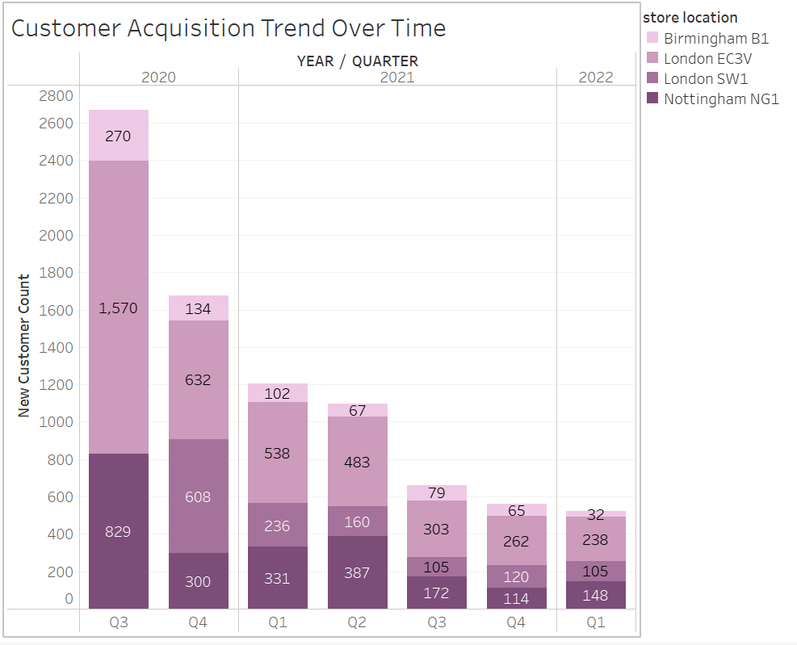
B. Customer Behavior Metrics – KPI 3 :New Customers/ First Time Buyers.
Purpose: to calculate new customers per quarter in each store.
Formula: Min Purchased at per quarter to calculate new customers, count of customer id.
c) Insights :
2020 Peak: The highest customer acquisition occurred in Q3 2020, with Birmingham B1 and London EC3V contributing significantly.
Decline Over Time: There is a steady decline in customer acquisition from 2020 to 2022, across all locations.
Consistent Performance: Despite the decline, London EC3V shows relatively consistent acquisition numbers compared to other locations.
Figure 3 : Customer Acquisition Trend Over Time

Slide 6
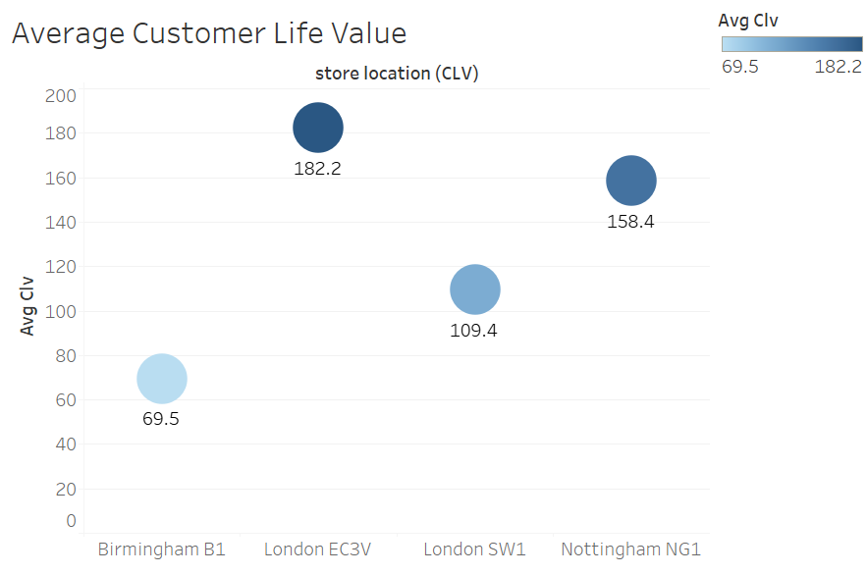
B. Customer Behavior Metrics – KPI 4: Customer Lifetime Value (CLV)
a) Purpose: Quantifies customer value over their relationship with the store.
b) Formula: Average total revenue per customer per quarter, per store within their respective first and last purchase date
c) Insights :
Highest CLV: London EC3V leads with the highest average CLV at 182.2, indicating a highly valuable customer base.
Lowest CLV: Birmingham B1 has the lowest CLV at 69.5, reflecting less customer profitability.
Mid-performing Locations: Nottingham NG1 (158.4) and London SW1 (109.4) have moderate CLV values, with Nottingham significantly outperforming London SW1.
Figure 4 : Customer Lifetime Value Trend

Slide 7
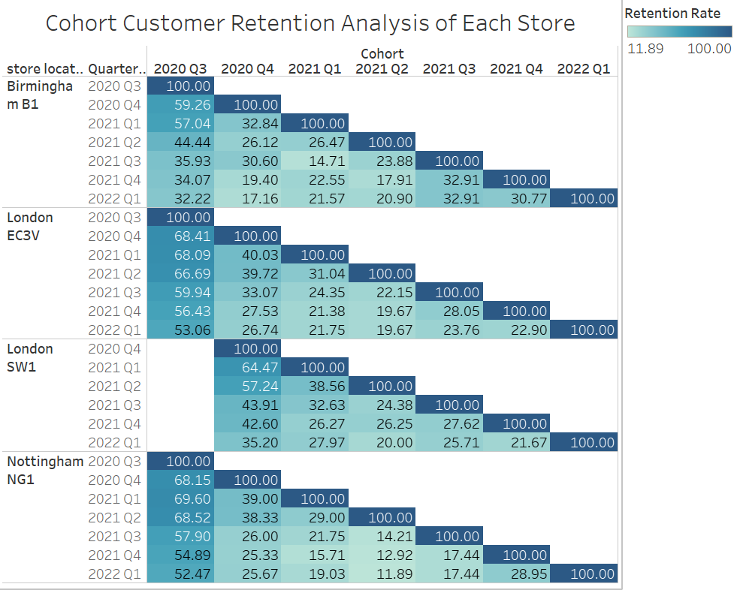
B. Customer Behavior Metrics – KPI 5: Cohort Retention Analysis
a) Purpose: It tracks how well the business retains its customer base per cohort, per store.
b) Formula: (retained customer base/cohort size)*100, per store, per quarter. c) Insights : 1.Initial Retention (Quarter 0): Each cohort starts with a 100% retention rate in the first quarter (since it includes all the customers who made a purchase in that cohort).
2.Retention Over Time: Retention rates tend to decline over subsequent quarters, indicating customer churn. Some cohorts stabilize with certain retention levels, reflecting a loyal customer base that continues to make purchases.
3.Store Location Performance:
a)Birmingham B1 shows relatively lower long-term retention compared to other locations. b)Nottingham NG1 has higher initial retention rates across most cohorts, maintaining better performance in later quarters.
4. Retention Patterns: In some cohorts, retention drops sharply in the first few quarters but stabilizes later (e.g., London SW1, 2020 Q4 cohort). Certain cohorts demonstrate seasonal behaviour, where retention improves in specific quarters.
Figure 5: Cohort Customer Retention Per Store

Slide 8
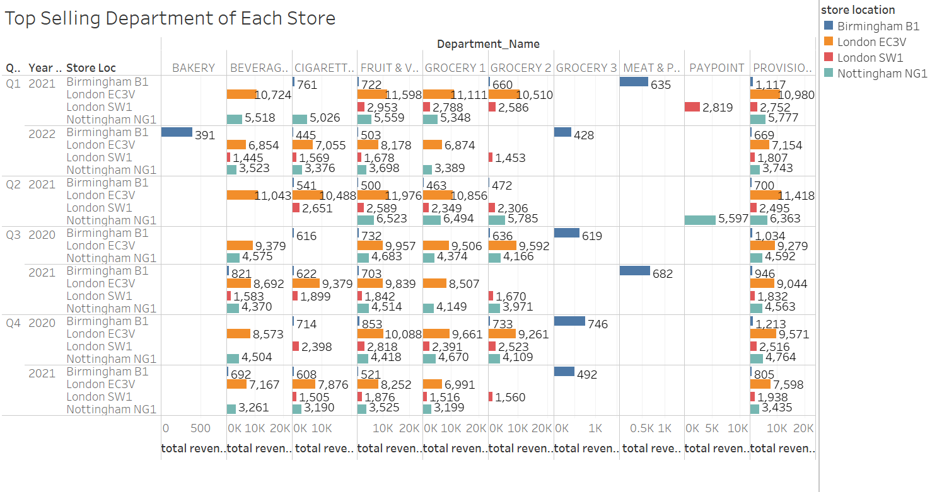
C. Product Performance Metrics – KPI 6: Top Five Selling Department.
a) Purpose: It identifies which department made most of the sales revenue.
b)Formula: Total sales value per department per quarter.
c) Insights : 1.High-Performing Departments: i) London EC3V: Dominates in "Grocery 1" and "Provision" departments consistently across quarters. Also performs well in "Fruit & Vegetables" and "Meat & Poultry" categories. ii) Nottingham NG1: Strong revenue from "Grocery 1" and "Provision" departments. "Fruit & Vegetables" consistently contribute significantly. iii) Birmingham B1: Limited performance across departments, with sporadic sales in "Meat & Poultry" and "Provision.“ iv) London SW1: Moderate performance in "Grocery 1," "Fruit & Vegetables," and "Provision". Sales vary significantly by department and quarter.
2.Underperforming Departments: i) "Cigarettes" and "PayPoint" generate low revenue across all stores. Ii) Birmingham B1 consistently underperforms across all departments, particularly in "Grocery" and "Provision."
Figure 6 : Top Five Selling Department of each store
3. Seasonal Trends:
"Fruit & Vegetables" and “Provisions" show stable demand across quarters, likely reflecting consistent customer needs.

Slide 9
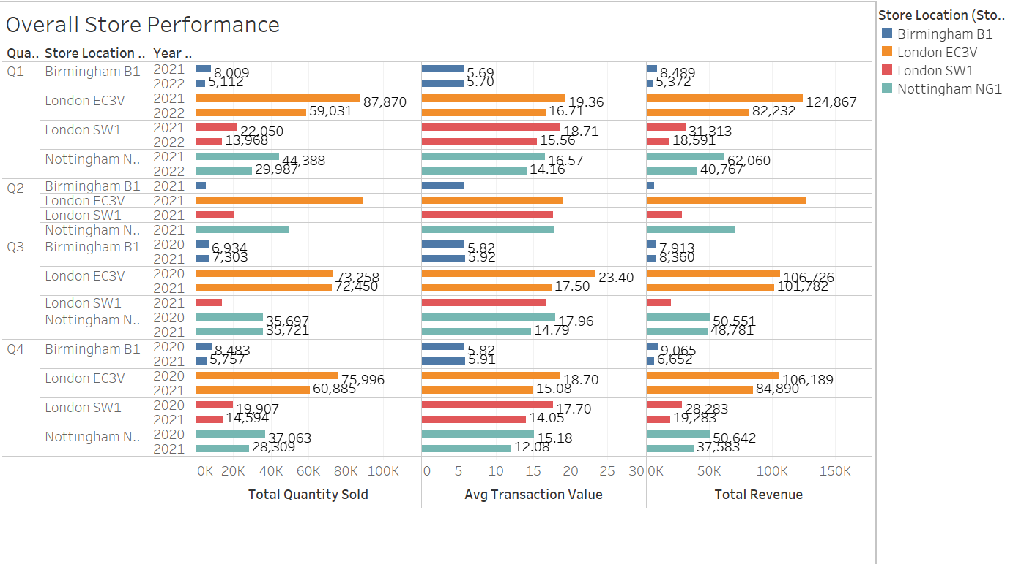
D. Store Performance Metrics – KPI 7: Store Performance Trend Over Time.
a) Purpose: It gives overall store performance per store location, per year-quarter.
b) Formula: Total quantity sold, total transactions, total revenue per quarter, per stores.
c) Insights : 1. Top Performer - London EC3V: Consistently generates the highest total revenue and total quantity sold across all quarters and years. The store's performance significantly outpaces others, especially in 2021 and 2022.
2.Nottingham NG1's Steady Growth: Nottingham NG1 shows consistent performance with strong contributions to both total revenue and quantity sold. It ranked second across most quarters, suggesting a stable customer base.
3.London SW1's Variability: London SW1 has moderate but inconsistent performance, with revenue and sales fluctuating by quarter.
4.Birmingham B1's Underperformance: Records the lowest total revenue and quantity sold across all periods. A consistent struggle to compete with other stores in all quarters and years.
Figure 7: Overall Store Performance Trend

Slide 10
Business Recommendations:
1. Focus on High-Performing Stores: London EC3V achieves the highest sales and revenue across all quarters consistently. This location should be prioritized for expansion or product experimentation.
2. Improve Retention in Birmingham and Nottingham: The cohort analysis indicates lower customer retention rates in Birmingham B1 and Nottingham NG1 compared to other locations. Consider targeted retention strategies such as loyalty programs or personalized promotions.
3. Focus on High-CLV Locations & Revitalize Low-CLV Locations: Prioritize marketing and customer retention efforts in London EC3V and Nottingham NG1, as they demonstrate strong customer profitability. Investigate and address factors contributing to the low CLV in Birmingham B1 through customer satisfaction surveys or targeted promotions. 4.Enhance Underperforming Departments: Certain departments, such as Bakery and Cigarettes, have significantly lower revenue across most locations. Focus on improving product offerings or marketing for these departments.
5.Improve Birmingham B1's Performance: Conduct market research to identify customer preferences and address gaps in product offerings. Launch aggressive promotions for underperforming departments to drive sales.
6.Seasonal Sales Optimization: The quarters which consistently show higher sales across most stores. ,use this trend to plan promotional campaigns and inventory stocking during these peak periods.

Slide 11
Q & A

